Slide 1
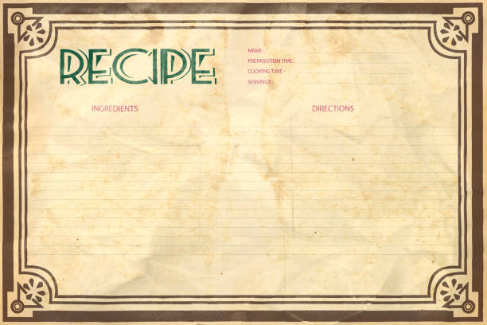
Recipe Search

Slide 2
Elevator pitch

Slide 3
Concept
This is a website that allows users to enter a type of food and get multiple recipes back.
We all like to cook and enjoy food
AS a home cook, I WANT to find recipes, SO THAT I can try new dishes.

Slide 4
Process
Technologies used
Breakdown of tasks and roles
Challenges
Successes

Slide 5
Demo

Slide 6
Directions for Future Development
Add option for random search
Add page implementation to search results

Slide 7
Links
Deployed
GitHub repo

